Slide 1
Modern Control Theory
Model Predict Control - MPC – Lecture 9
Unconstrained Control move calculation - MIMO

Slide 2
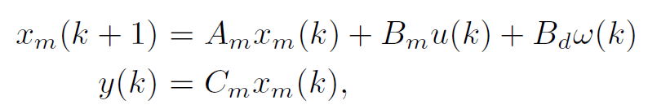

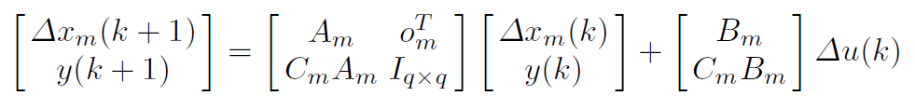
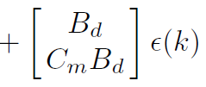




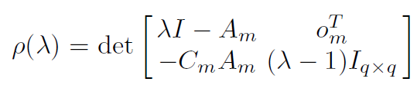

Prediction using State space models - MIMO
m inputs, q outputs and n1 states
For good control q <=m
w(k) is integrated white noise
Am is n1 x n1
Bm is n1 x m
Bd is n1 x m
Cm is q x n1
u is m x 1
y is q x 1
Incremental form
Augmented
‘q’ Integrators

Slide 3
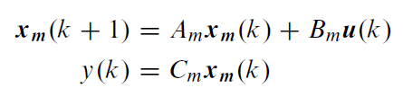

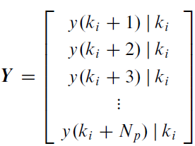
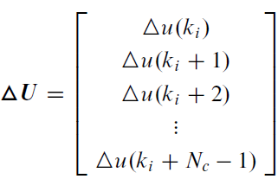
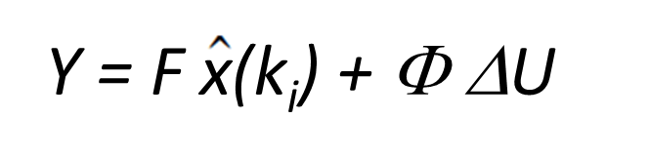
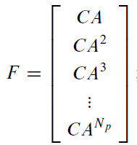
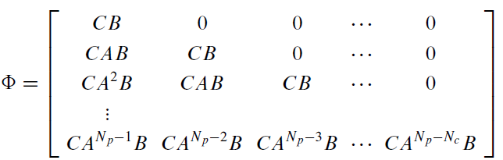
Prediction using State space models - MIMO
System
representation
System in incremental form
y(k+1) = C x(k)
Output Prediction equation
q*NpX 1
Output Prediction equation
m*Nc X 1
(q*Np x (n1+q)
q*Np x m*Nc

Slide 4




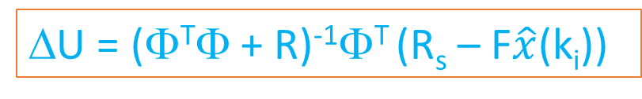
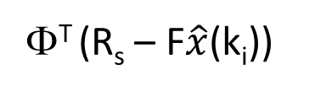
Unconstrained solution – MIMO
Now
=
^
+
= 0
(Φ^{T}Φ+ R)ΔU =
Φ^{T} (R_{s} – F$\hat{x}$(k_{i}))
Solving for ΔU we get
Implementation steps ONLINE
Obtain the current measurements of states,
Estimate the states using Kalman filter
Compute the optimal finite horizon control sequence (u_{k}, u_{k+1}, …u_{M})
Implement first move u_{k} for each of the inputs
Repeat from Step 1
ΔU = (Φ^{T}Φ + R)⁻¹Φ^{T} (R_{s} – F$\hat{x}$(k_{i}))
u_{ki} = u _{(ki-1)} + Δu_{ki}
(first m value in ΔU)

Slide 5
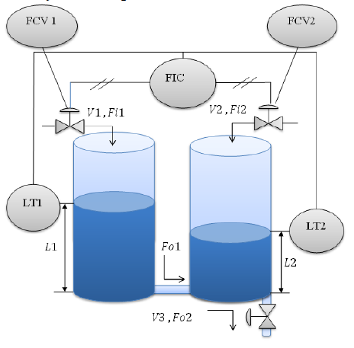






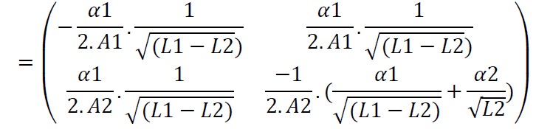

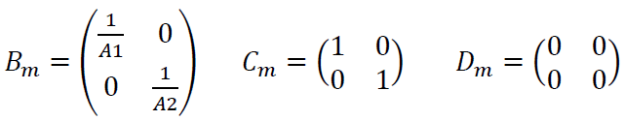
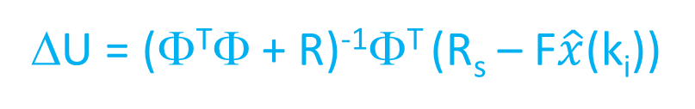
Example problem
Level control of coupled tanks
Linearize around some operating point (h1.h2), we get
A_{m}
Matrices to compute:
Φ, F, Φ^{T}Φ, Φ^{T} R_{s ,} Φ^{T} F
ΔU = (Φ^{T}Φ + R)⁻¹Φ^{T} (R_{s} – F$\hat{x}$(k_{i}))

Slide 6



Demo
Linearize around L1 = 4m, L2 = 3.5m
Sampling time = 0.05 secs, discretize
Np = 10, Nc = 3

Slide 7
Handling constraints
Inputs
Rate of change constraints on the input – (Δu)
Absolute constraint (u)
Output
Output limits - y
Inputs – Hard constraints – cannot be violated
Output – Soft constraints – violation allowed with some penalty

Slide 8
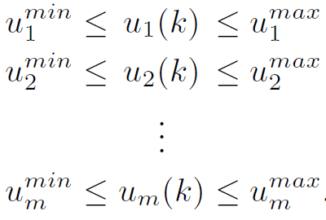




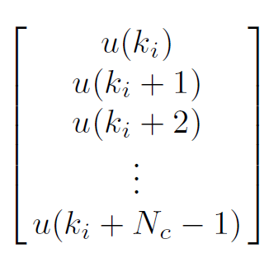
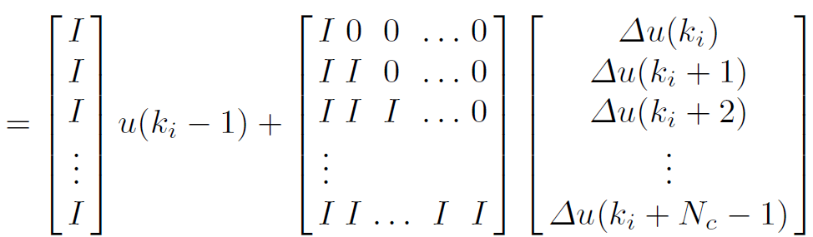





Handling input constrains – Amplitude of control signal u
Decision variable is Δu
Example: SISO Nc = 4
-
C1
C2

Slide 9
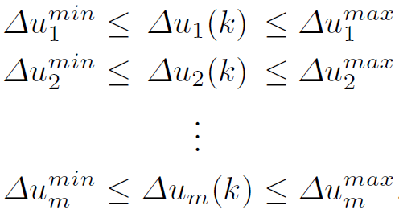
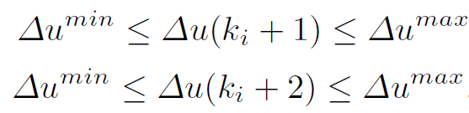


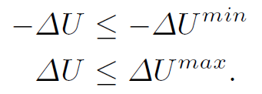
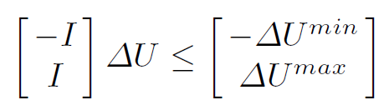

Handling input constraints - incremental change in inputs
Decision variable is Δu
Rate of input change: Most easy constraint to include

Slide 10

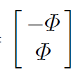
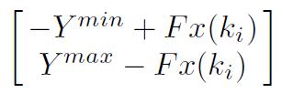


Handling output constraints – control limits
y1_{min} < y1_{pred} (k)< y1_{max}
y2_{min} < y2_{pred} (k)< y2_{max}
….
yq_{min} < yq_{pred} (k)< yq_{max}
Y_{min} < Y_{pred} (k) < Y_{max}
Y_{min} < Y_{pred} (k+1) < Y_{max}
…
Y_{min} < Y_{pred} (k+Np) < Y_{max}
Y_{pred} = Fx(k_{i}) + ΦΔU

Slide 11


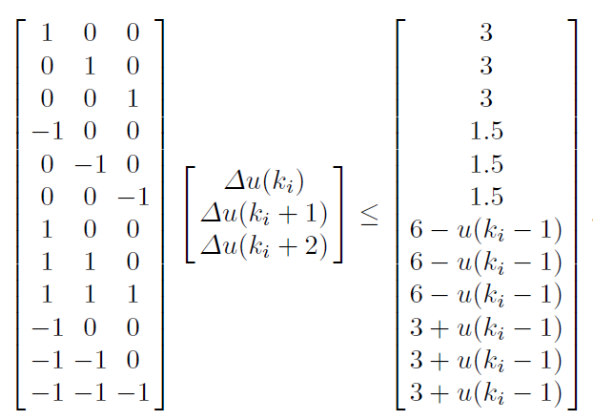
SISO Example – input constraints
Nc = 3

Slide 12
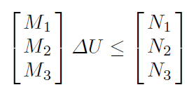








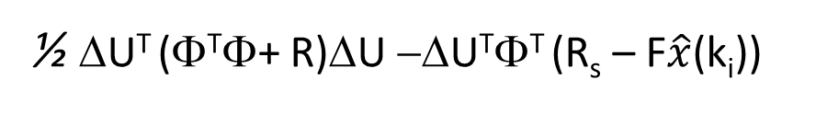
Handling constrains
Min
Δu
Min
Δu
Min
Δu
J/2 =
½ ΔU^{T} (Φ^{T}Φ+ R)ΔU −ΔU^{T}Φ^{T} (R_{s} – F$\hat{x}$(k_{i}))
Ε = Φ^{T}Φ+ R
G = Φ^{T} (R_{s} – F$\hat{x}$(k_{i}))
Min
Δu
J’= ½ ΔU^{T} EΔU + ΔU^{T} G
This is standard Quadratic programming (QP) with
E called the Hessian – symmetric positive definite
Input amplitude
Subject to
Input rate of change
Linear in constraints
Output rate of change

Slide 13
Solving QP problem
Active set method based on Lagrange multipliers
Interior point methods

